Slide 1
AI for ALL Practical Application & Implementation
Module 00 – Course Objectives

Slide 2
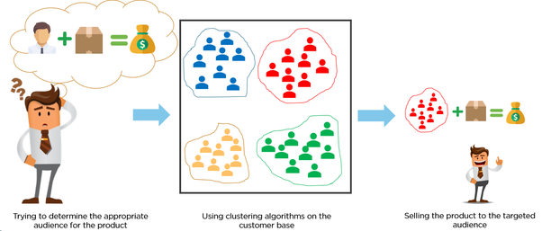
Objective: To become an AI solution provider
Create A Solution using AI to Separate Audiences and Rank Them
Notes:
KLP: Understand that AI helps us to make the right decision.
The objective of this course is to become an Artificial Intelligence (AI) solution provider, BUT what do we mean by that?
What does it mean to be an AI solution provider?
What is AI? What type of solution is provided? Let’s talk about that a little bit more.
This slide shows the overall picture of WHAT we are trying to do here in this course.
Everyday we make decisions continuously like breathing. In fact, each decision is a “solution” to do some action that creates value.
For example, before you start for office, you saw rain forecast and decided to take umbrella so that you don’t get wet, that’s a decision.
For businesses, suppose your client is a selling a product (whatever product you can imagine, a car for example), and she/he must promote his product for maximum sale, but unfortunately, she/he does NOT have unlimited money to reach all the people in the world, SO she/he wants to reach only customers with highest probability of buying his product (in this case say a car). In other words, she/he is trying to determine the right group of customers to target the promotion so that his product sale is maximum.
So that persons comes to YOU for a solution. How do you that? (ask the question to the audience)
Well, you can use as you have said, a DECISION-MAKING PROCESS using critical thinking to assess all the data available.
However, nowadays we can make use of latest computer capabilities, and use AI technology AI to help you out sorting the targeted customers to maximize sales.
Basically, you are analyzing all the data available to produce a price for a product for your target market. BUT that analysis is not that simple!!
Next slide.

Slide 3
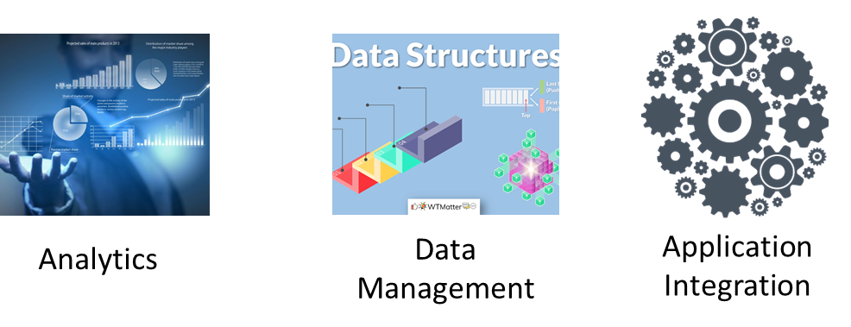
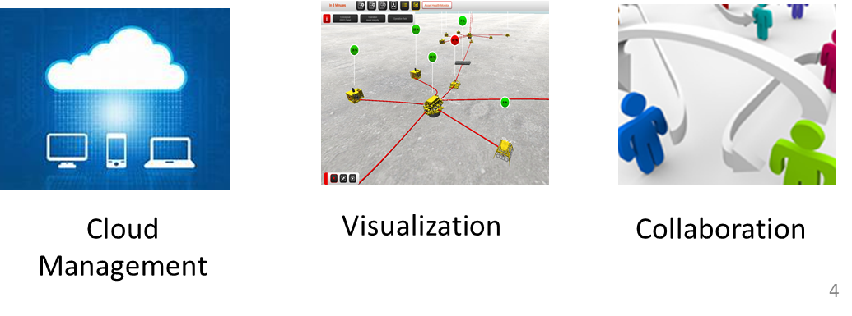
Objective: To become an AI solution provider
Create A Solution using AI to Separate Audiences and Rank Them
Notes:
KLP: Understand that AI helps us to make the right decision, by properly analyzing the data thru a structured methodology.
Analyzing the date is not that simple. We require to have a METHODOLOGY, following different PROCESSES.
An Artificial Intelligence solution will require at least 4 or 6 of the following PROCESSES:
Analytics or AI source code,
Data management,
Application Code Integration
Cloud Management,
User Management (collaboration) and
Visualization.
Next slide

Slide 4
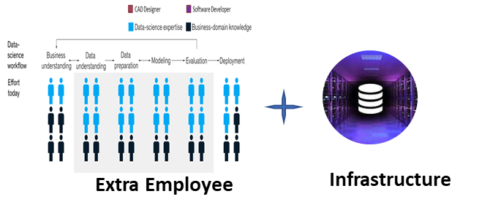
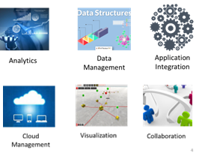
Objective: To become an AI solution provider
Create A Solution using AI to Separate Audiences and Rank Them
Notes:
KLP: Understand that AI helps us to make the right decision, and the methodology involves several resources.
To put together this methodology it may require around 20 to 25 skilled people who are experts in different disciplines.
Next slide

Slide 5
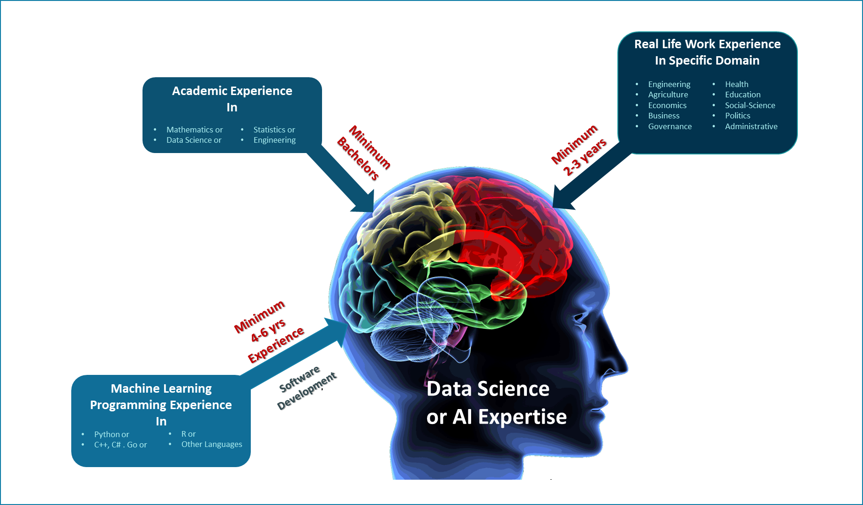
AI delivery capacity Requirement
Team
Business - SMEs /SDEs
Data Scientists
Data Engineers
User Interface Frontend Engineer
Solution Architect
DevOps-cloud engineer
Infrastructure
Cloud Storage
Cloud Computation
High performance PC
Cumulative Training
Min. 6 Year
Investment
$3m -$5m
Notes:
KLP: Understand that AI helps us to make the right decision, and the methodology involves several resources.
To put together this methodology it may require around 20 to 25 skilled people who are experts in different disciplines.
What type of experts we need? To break it apart you would require a team with:
Business Subject Matter Experts (SMEs) or also called SDEs (Subject Domain Experts)
Data Scientists,
Data Engineers,
Software Developers, etc.
In terms of infrastructure, you are looking at:
Cloud Storage
Cloud Computation
Powerful Computers.
In terms of training, these people’s training may be between 2 to 6 years do perform.
[click] For example, a Data Scientist requires:
4-year Bachelor Degree
4 to 6-year programming experience
2 to 3-year real life experience
To develop a GOOD Data Scientist is a HARD TASK, with several years of experience so she/he can create solutions that add value.
Finally, in terms of CAPEX, we are looking at putting millions of dollars to develop the team AI capabilities.

Slide 6
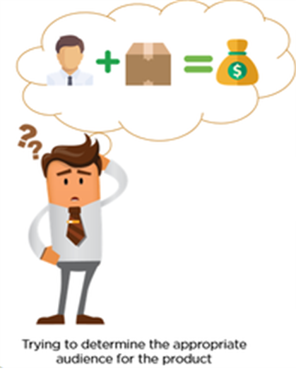
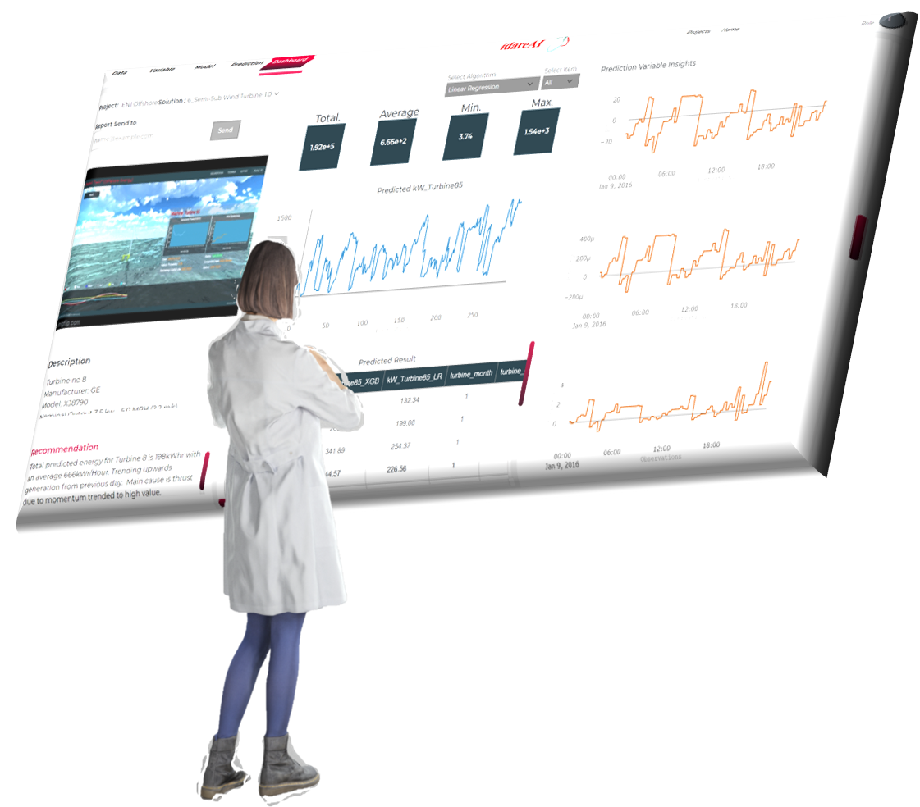
This course will develop your capacity to provide AI solution
IDARE autoML
Notes:
KLP: Understand that anyone in the audience can became an AI solution provider using IDARE autoML Tool
So, IMAGINE you can become an AI solution provider!!!
IMAGINE you can produce solutions for your Clients business needs WITHOUT all those applications and all those experts!!!!
HOW?
IDARE have created a tool for our own use which in fact is a robot that does perform the tasks that all those high skilled people do (data scientists, data engineers, software developers, etc.).
This robot inside the machine writes an AI solution code and run software applications behind it.
This robot is NOT meant for public even though IDARE do client training when a solution is created using this tool.
However, we have met MIST team and specially commandant Maj. Gen Wahid, who is a visionary to spread AI creating value for his country, and as an extraordinary exception, we decided to help Bangladesh with our IDARE AI autoML tool under MIST care.
We hope that, utilizing this tool along with your will power, you will be able to create AI solutions without going through such hurdles.
Next slide

Slide 7



So what will you learn
2 Hours
4 Hours
14 Hours
AI for Business
Role of AI in Business
Opportunities
AI Driven Decision Making in Different Sectors
AI Theories
Decision making process using AI
Understanding ML
AI Success & Performance Indicators
Practical AI Experience
AI Implementation for Production
Practical Experience using Robotic AI Tool idareAI for Different Sectors
Notes:
KLP: Understand the mechanics of the training.
As a part of this endeavor, IDARE have structure this course as follows:
AI for Business – 2 hours
AI Theories – 4 hours
AI Practical Experience – 14 hours
Good Luck.

Slide 8

Notes:
Any questions?

